Slide 1
Personalized Product Recommendations Data-Driven Insights.
Enhancing Customer Experience through Personalization
Presented By:
Scott, Kyle, Sonu

Slide 2
Problem Statement
Objective:
Enhance customer experience by providing personalized product recommendations.
Goals:
Identify different customer segments based on purchasing behavior.
Recommend products tailored to each segment.
Apply additional discounts for loyal customers.
Ensure recommendations match customer size preferences.
Limit recommendations to 20 products or less.
Calculate and present total amount, discount applied, and net total.
Business Logic
Customer Segments:
Discount Shoppers: Prefer discounted products.
Non-Discount Shoppers: Prefer non-discounted products.
High Purchase Shoppers: Have made 30 or more purchases.
High Rating Givers: Frequently give high ratings.
Product Recommendations:
Tailored to segment, gender, and size preferences.
Additional 20% discount for high purchase shoppers.
Calculation:
Total amount.
Discount applied.
Net total.

Slide 3
Business Logic
Customer Segments:
Discount Shoppers: Prefer discounted products.
Non-Discount Shoppers: Prefer non-discounted products.
High Purchase Shoppers: Have made 30 or more purchases.
High Rating Givers: Frequently give high ratings.
Product Recommendations:
Tailored to segment, gender, and size preferences.
Additional 20% discount for high purchase shoppers.(30 or more)
Calculation:
Total amount.
Discount applied.
Net total.

Slide 4
Data Loading and Preprocessing
Load Data:
Product data and customer purchase history from CSV files.
Preprocessing:
Convert 'Yes'/'No' to 1/0.
Handle non-numeric values and ensure numeric types.
Notes:
import pandas as pd
product_df = pd.read_csv('product_data.csv')
product_df['Discount_Applied'] = product_df['Discount_Applied'].map({'Yes': 'Yes', 'No': 'No'})
product_df['Gender'] = product_df['Gender'].astype('category')

Slide 5
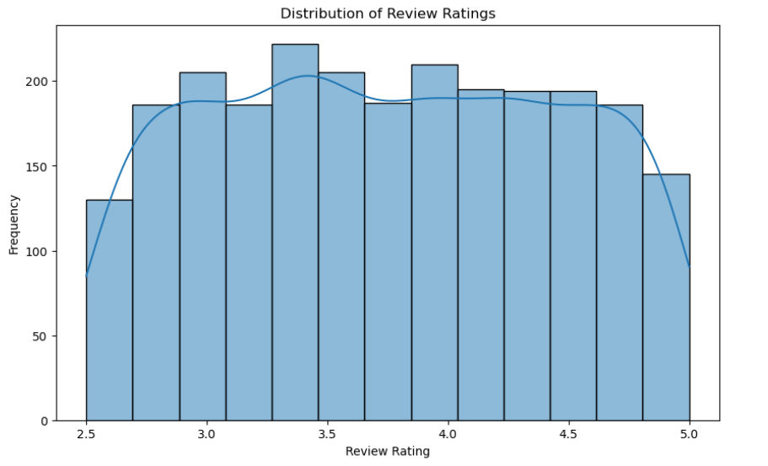
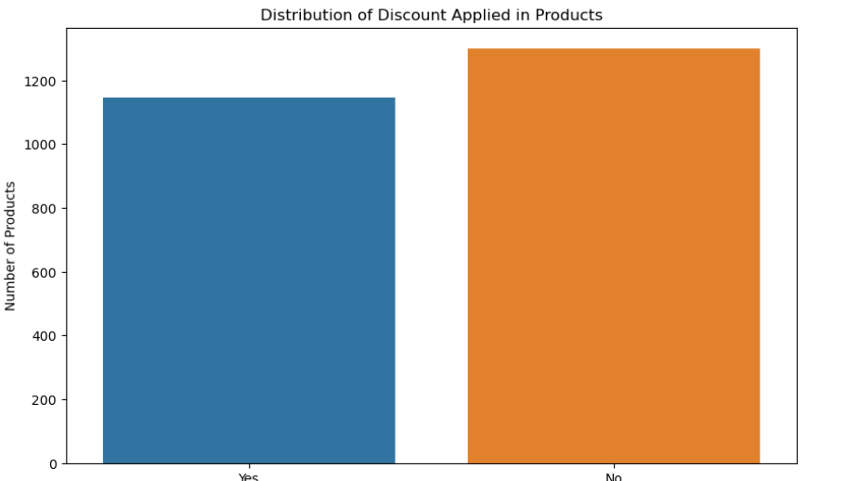
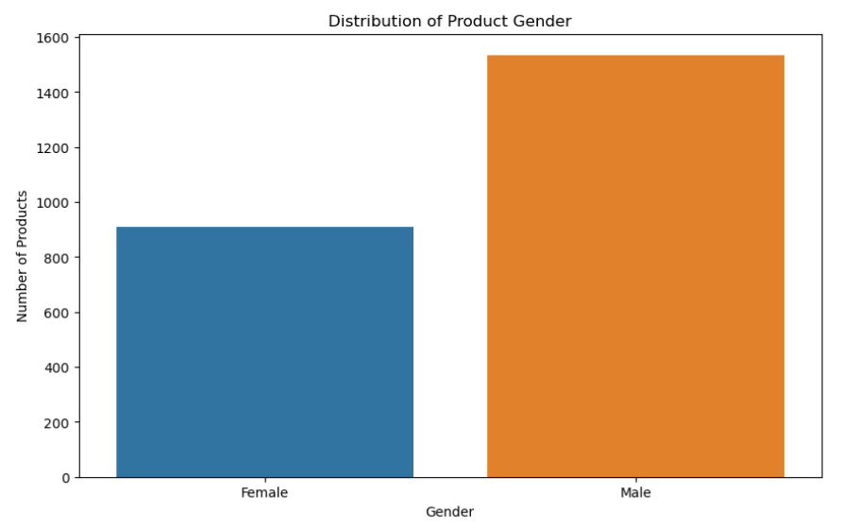
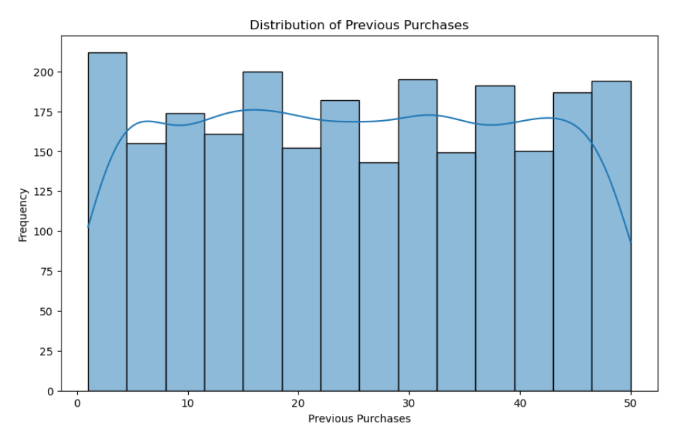
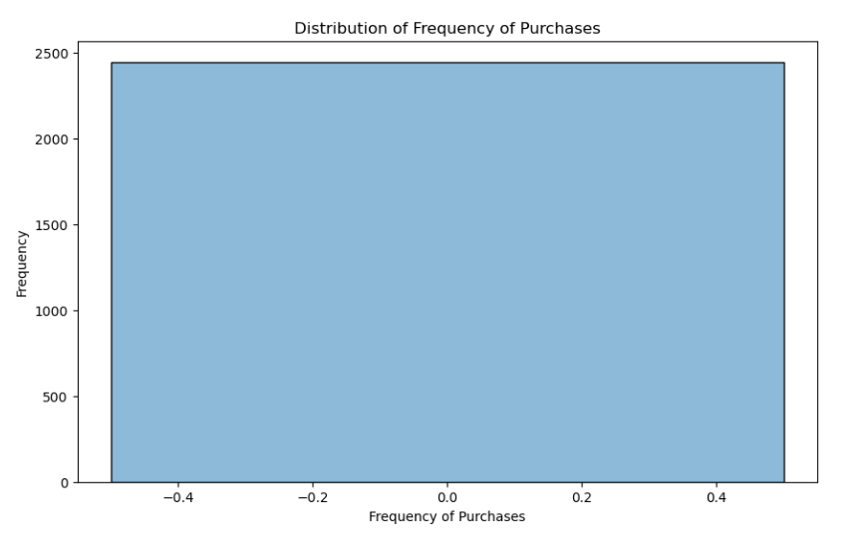
Understand data distributions.
Visualizations:
Distribution of discounts and gender for products.
Distributions of review ratings, previous purchases, and purchase frequency for customers.

Slide 6
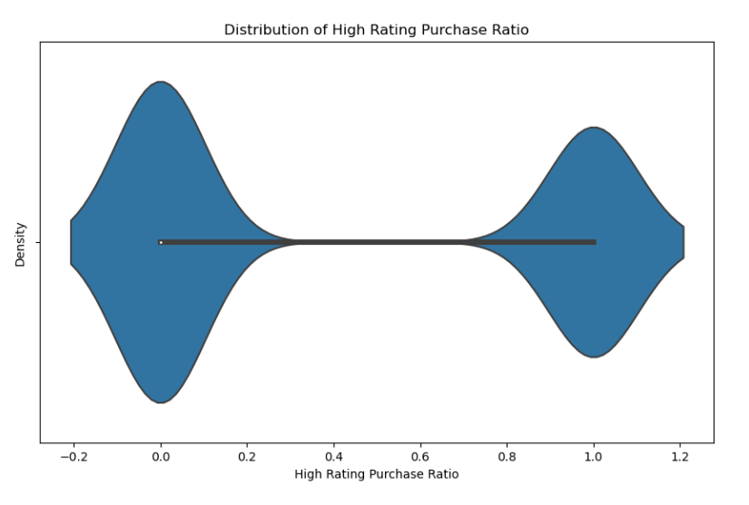
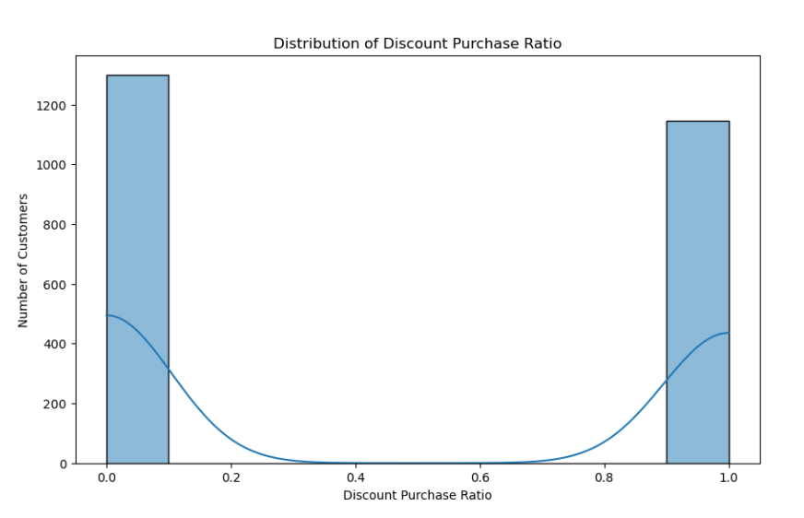
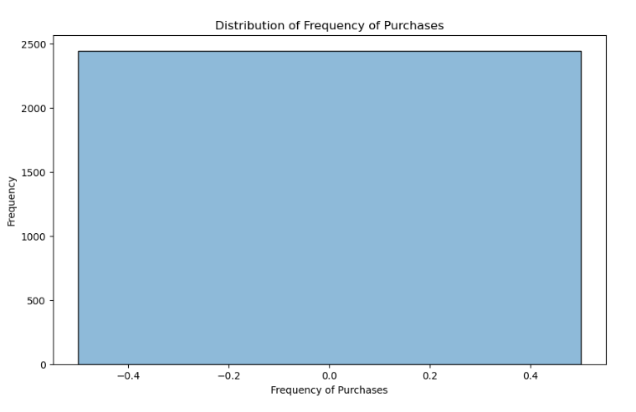
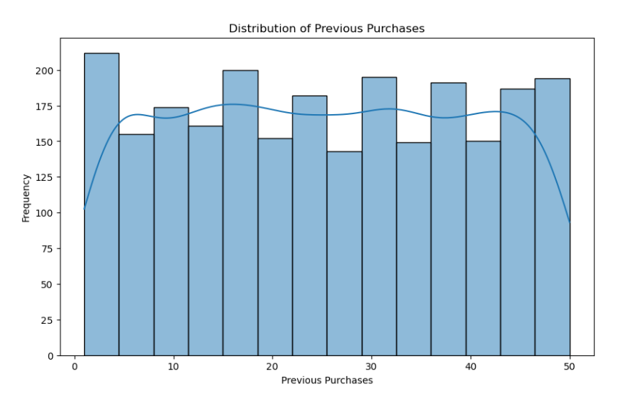
Feature Engineering
New Features:
Discount_Purchase_Ratio: Ratio of discounted purchases.
High_Rating_Purchase_Ratio: Ratio of high-rated purchases.
Previous_Purchases: Maximum previous purchases.
Frequency_of_Purchases: Maximum purchase frequency.
Notes:
Discount Purchase Ratio - The boxplot suggests that the Discount Purchase Ratio for the customers in the dataset is uniform or nearly identical across all customers.If all customers have the same ratio, the boxplot will appear as a single line or block.This might indicate an issue with the data or the calculation. For example, if all customers only purchased discounted items or non-discounted items, the ratio would be 1 or 0 for everyone.T
Violin Plot for "High Rating Purchase Ratio“- Shows the distribution and density of high rating purchase ratios, indicating customer satisfaction behavior.

Slide 7
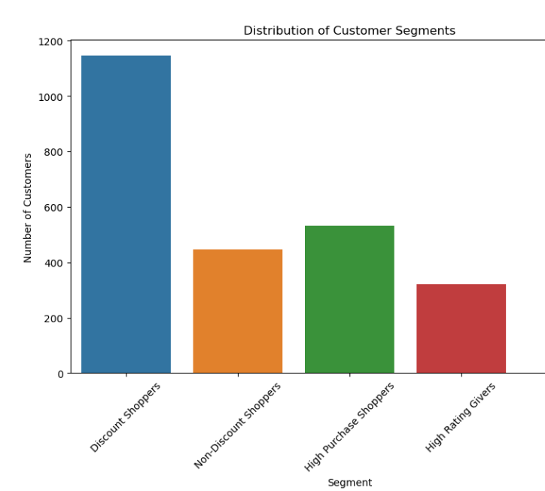
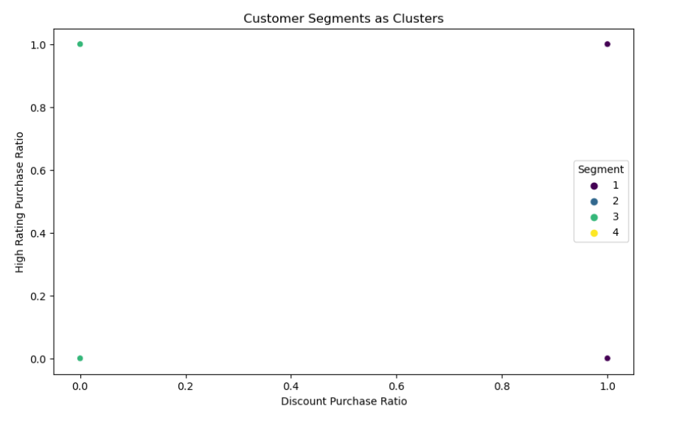
Customer Segmentation
Segments:
Discount Shoppers, Non-Discount Shoppers, High Purchase Shoppers (30&), High Rating Givers.
Conditions:
Discount_Applied'] == 1), (df['Discount_Applied'] == 0) & (df['Previous_Purchases'] < 30) & (df['Review_Rating'] < high_rating_threshold), (df['Previous_Purchases'] >= 30), (df['Review_Rating'] >=

Slide 8
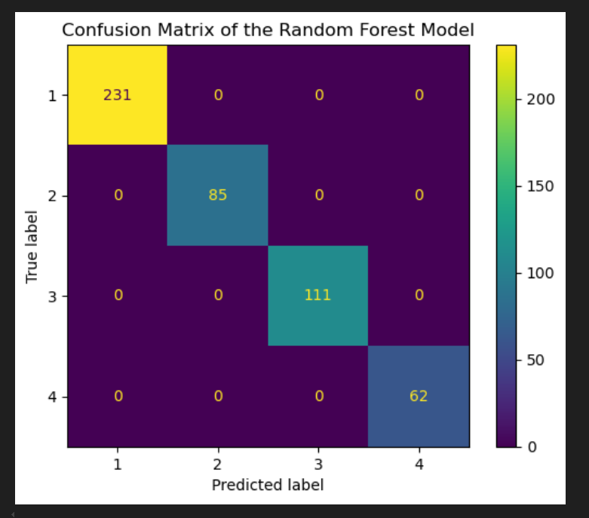
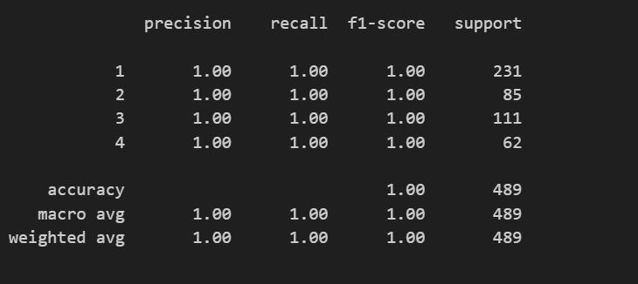
Model Training
Purpose: Predict customer segments.
Model: Random Forest Classifier.
Evaluation:
Classification report and confusion matrix.

Slide 9
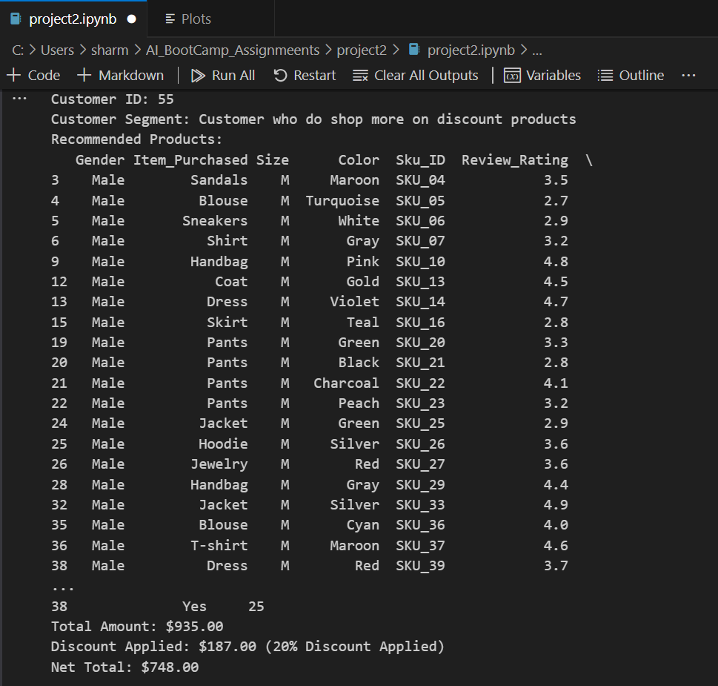
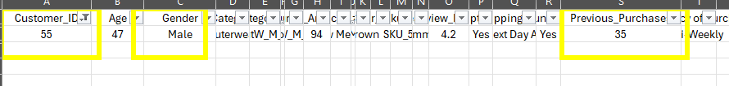
Product Recommendation
Logic:
Recommend products based on segment, gender, and size.
Apply additional 20% discount for high purchase shoppers.(30 & above)
Limit recommendations to 20 products or less.

Slide 10
Calculation of Totals
Calculation:
Total amount.
Discount applied.
Net total.

Slide 11
User Interaction
Main Function:
Visualize segments and clusters.
Prompt for Customer ID.
Segment customer and provide recommendations.
Display totals.
Notes:
def main():
customer_id = int(input("Enter Customer ID: "))
customer_segment = segment_customer(customer_id)
customer_size = customer_data['Size'].mode()[0]
recommended_products = recommend_products(customer_segment, customer_gender, customer_size)
total_amount, discount_applied, net_total = calculate_totals(recommended_products)
print(f"Total Amount: ${total_amount:.2f}")
print(f"Discount Applied: ${discount_applied:.2f}")
print(f"Net Total: ${net_total:.2f}")

Slide 12
Summary
Enhanced Customer Experience:
Personalized product recommendations.
Additional discounts for loyal customers.
Consideration of size preferences.
Calculation of totals for transparency.
Outcome:
Improved customer satisfaction.
Potential increase in sales.
Fostered customer loyalty.

